Slide 1
Introduction
Central pattern generators
Neurons
Stereotypic behaviors
Bursting neurons
Burst

Slide 2
Introduction
Phase Resetting Curves can be used to understand how the intrinsic dynamics and synaptic input interaction will affect the network dynamics
Briefly about methods
Previous work on inhibition
Winfree work

Slide 3
Significance
There has been little experimental study done to investigate the biophysical mechanisms of phase resetting in bursting neurons
Can helps us to predict the phase response curve
Will provide better understanding of central pattern generators (CPGs) that control swimming, walking, flying etc

Slide 4
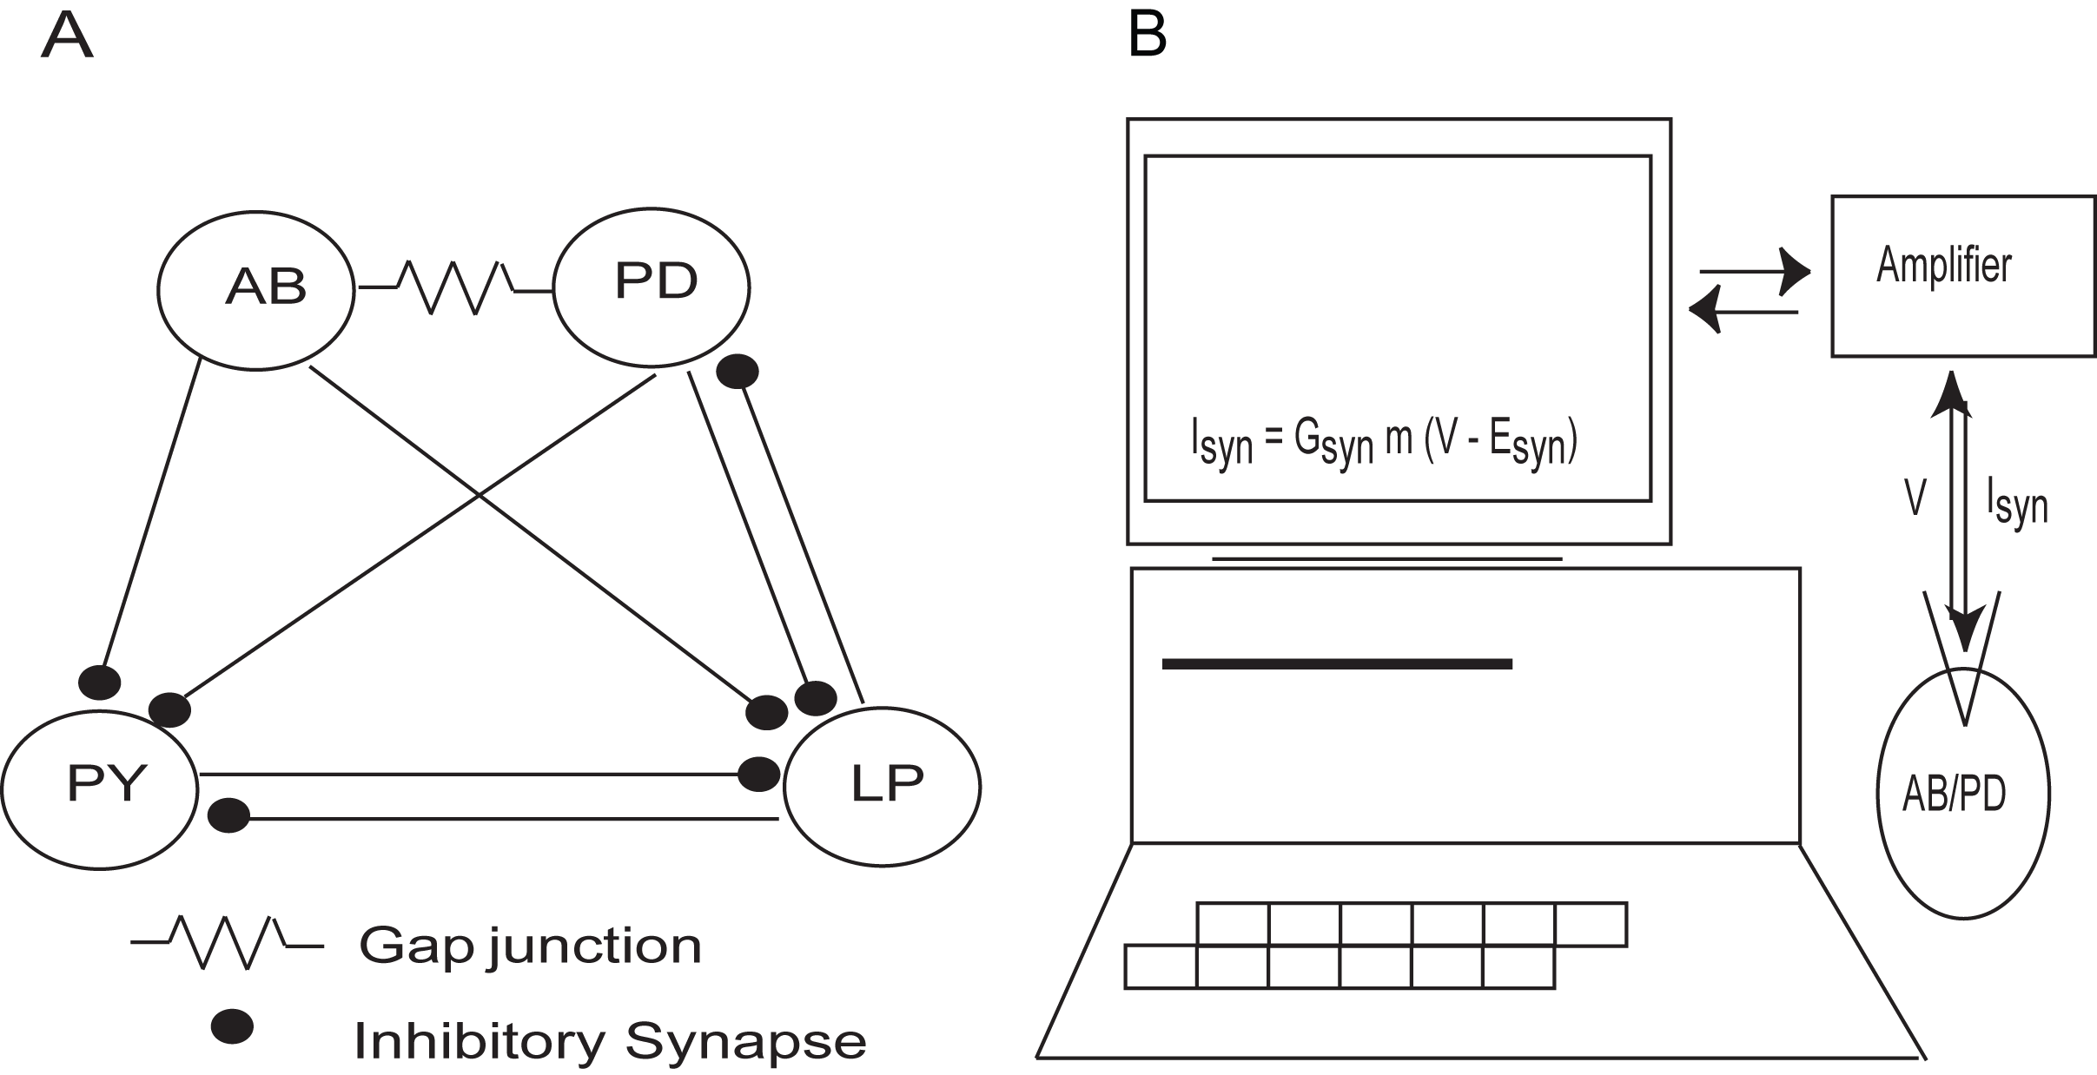
Methods
Simplified Pyloric Circuit
Experimental Set up
Dynamic clamp
Notes:
Experimental part and Modeling part, analysis
Done in Dr Astrid Prinz lab
Pyloric circuit (starting with an idea and then correcting it on the flow)
Experimental study done in , digestion
Neurons
Pacemaker
Block LP to isolate pacemaker
Why inject PD (missing crucial points and confusing with difficulty in preparation )
No excitatory connections
Experimental setup
-Dynamic clamp
Procedure
Why dynamic clamp

Slide 5
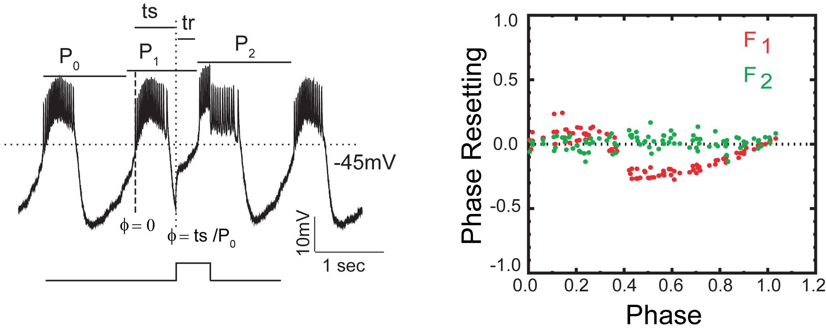
Methods(cont’d)
Phase Response Curve
F_{n}(Φ) = (P_{n(Φ)}- P₀)/P₀
n=1,2,3…
Notes:
What is phase resetting curve
How do we measure PR
Voltage trace (Slow Oscillation, truncated spikes)
P0,reference point, ts
phase
Phase resetting
PRC
Measure pr at phases from 0 to 1
PRC
x-axis is the phase and y-axis is the phase resetting (this you assume and miss)
Red, Green
Noise
- Positive , negative values mean ……..

Slide 6
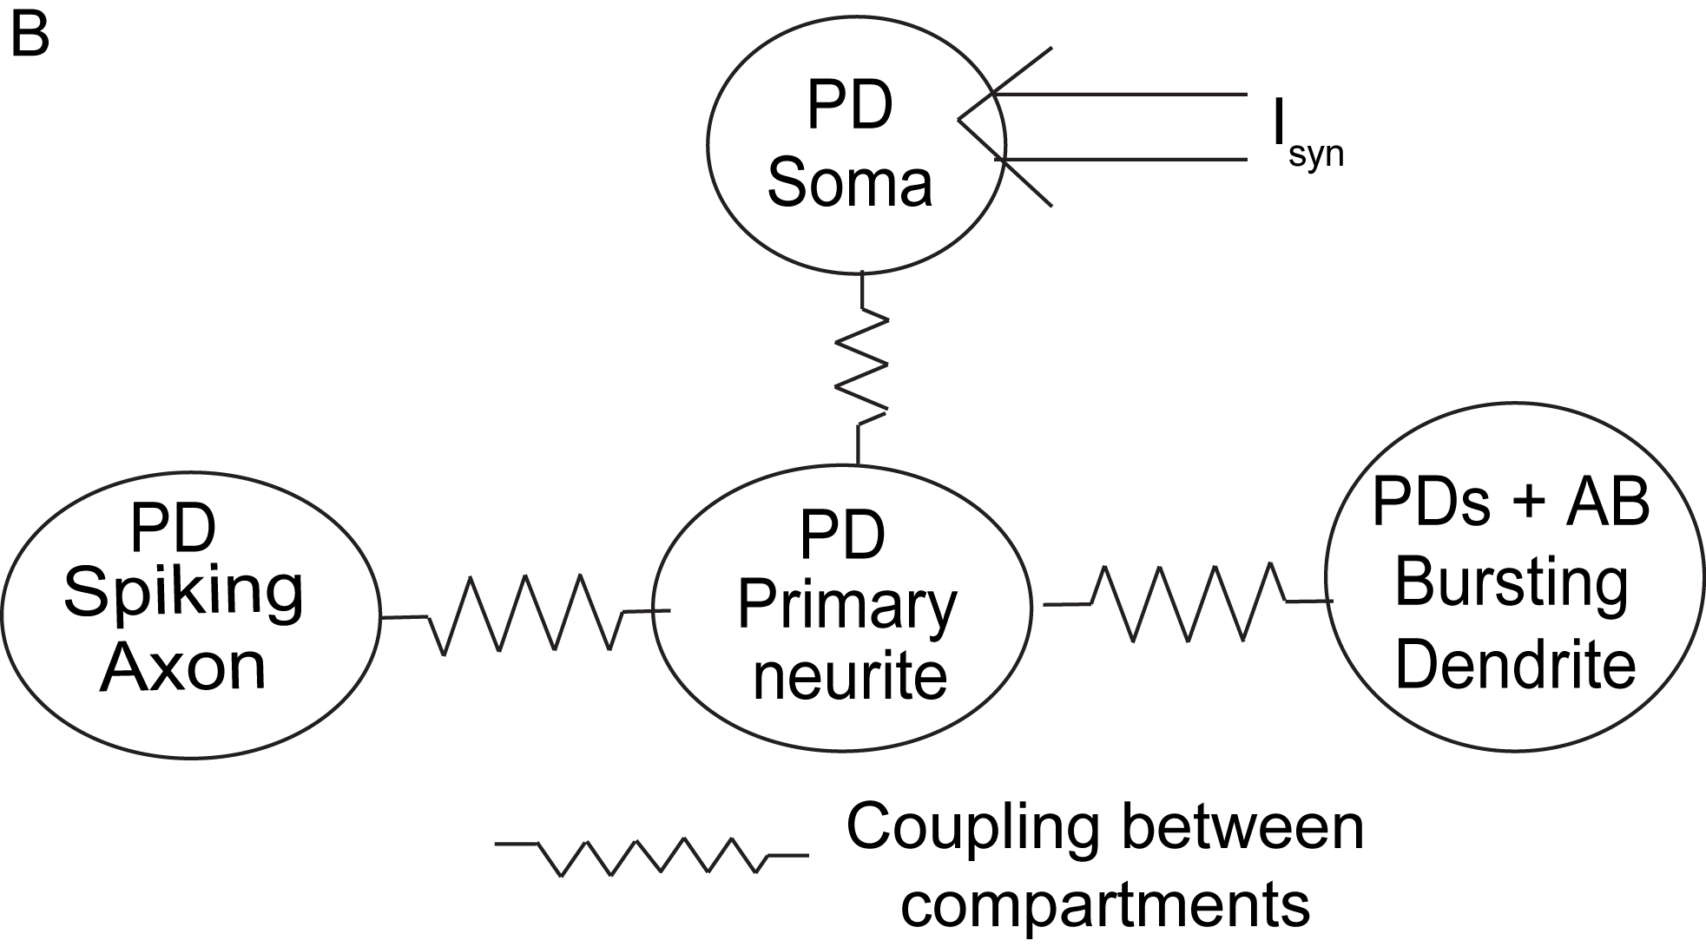
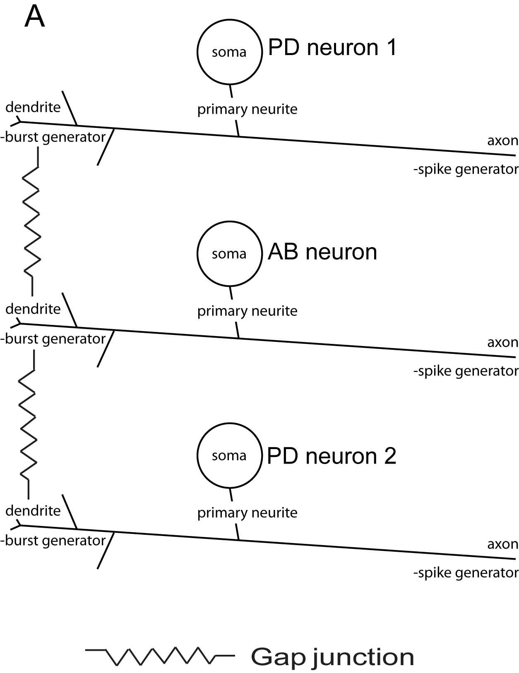
Model
All compartments have leak current
Dendrites
Fast I_{k}
Two slow currents
I_{CaS} and I_{CaK}
Soma
Receives synaptic input
Primary neurite
Very slowly activating K⁺ current
Axon
Spikes
I_{Na} and I_{K,dr}
We build the model based on the previous models and incorporating currents and compartments that can possibly explain the phase resetting that we observed
Notes:
Schematic structure of pacemaker complex
Model
Bursting Dendrites
Represents dendrites of 2 PD and 1 AB neurons
currents in each compartment
We build the model based on the previous models and incorporating currents and compartments that can possibly explain the phase resetting that we observed (this is the right sentence and you get confused)

Slide 7
Results – Experimental Datas
Duration Strength | Short | intermediate | long
Weak | 21(N=5) | 17(N=9) | 1(N=1)
Strong | 24(N=5) | 12(N=4) | 7(N=3)
N -> Number of neuronal preparation
Transitional cases - 7
Notes:
Weak and Strong and short, int. and long are relative
No of Experimental cases
N =
Weak short

Slide 8
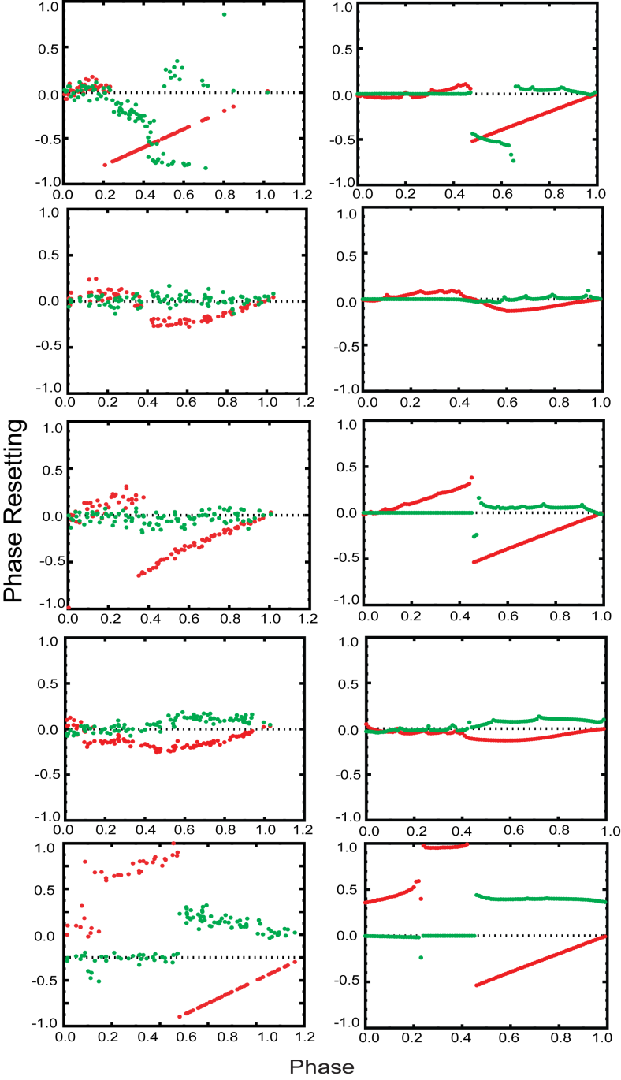
PRC summary
F₁ F₂
F₁ F₂
Strong Short Input
F₁ F₂
F₁ F₂
Weak Intermediate Input
The experimental PRCs that we observed, we were able to reproduce in the model that we built
F₁ F₂
F₁ F₂
Strong Intermediate Input
F₁ F₂
F₁ F₂
Weak long Input
F₁ F₂
F₁ F₂
Strong long Input
Biological PRCs Model PRCs
Notes:
Each category have different shapes
Biological and model
Just go around and show the similarity
More Noisy

Slide 9
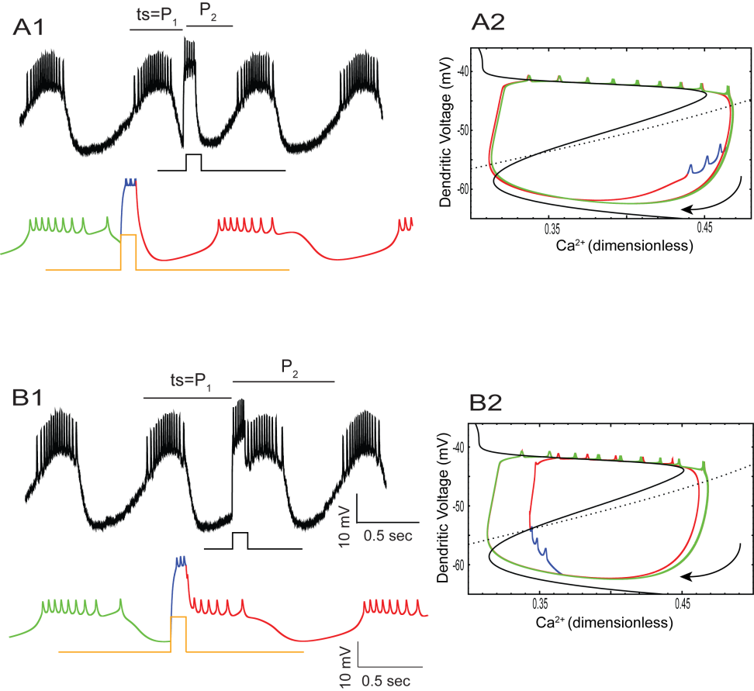
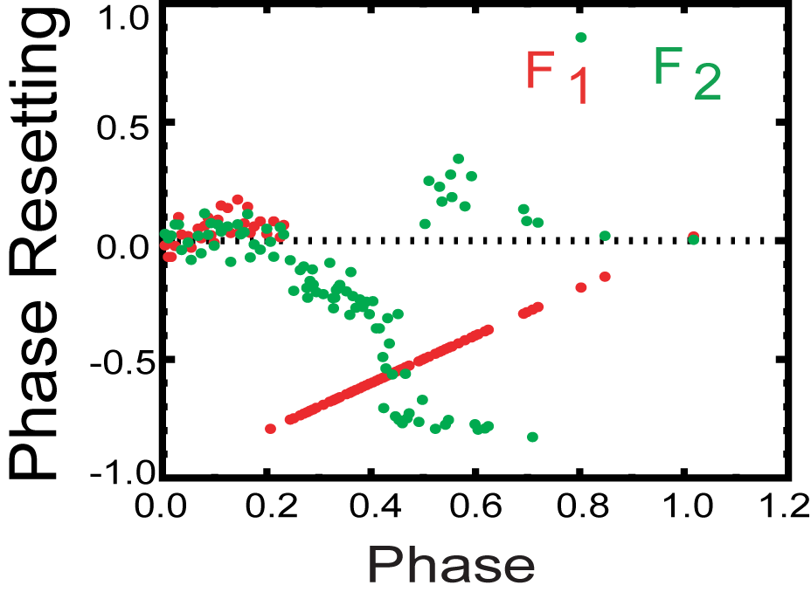
Short Strong Input
Upper branch
lower branch
F₁ = (P₁- P₀)/P₀ = (ts/P₀)- 1 = Φ-1
Green - Before input
Blue - During Input
Red - After Input
Notes:
Short weak
PRC
Caption
A1 and B1 Voltage traces
Bio, Model
Model color
A1, Input is given at, ….. Corresponds to in PRC diagram In B1, , Input is given at, ….. Corresponds to in PRC diagram
PRC structure
Evokes spikes immediately, ts=p1, click mouse
A1, End of input, P2, f2, why advance delay
A2
A2, B2 Phase plane
Fast, slow
Limit cycle, green, Upper (bumps,spikes) and lower branch (interburst), starts spiking when it goes upper branch
Red, green, flow
Nullclines
Don’t explain Jump between branches here but do it in next
Explain for this specific case
When the input is given, the neuron is in this phase space and what you see
Lower br but spikes
From voltage trace its not clear whether it jumps to upper branch or not, but from phase plane it
Main point

Slide 10
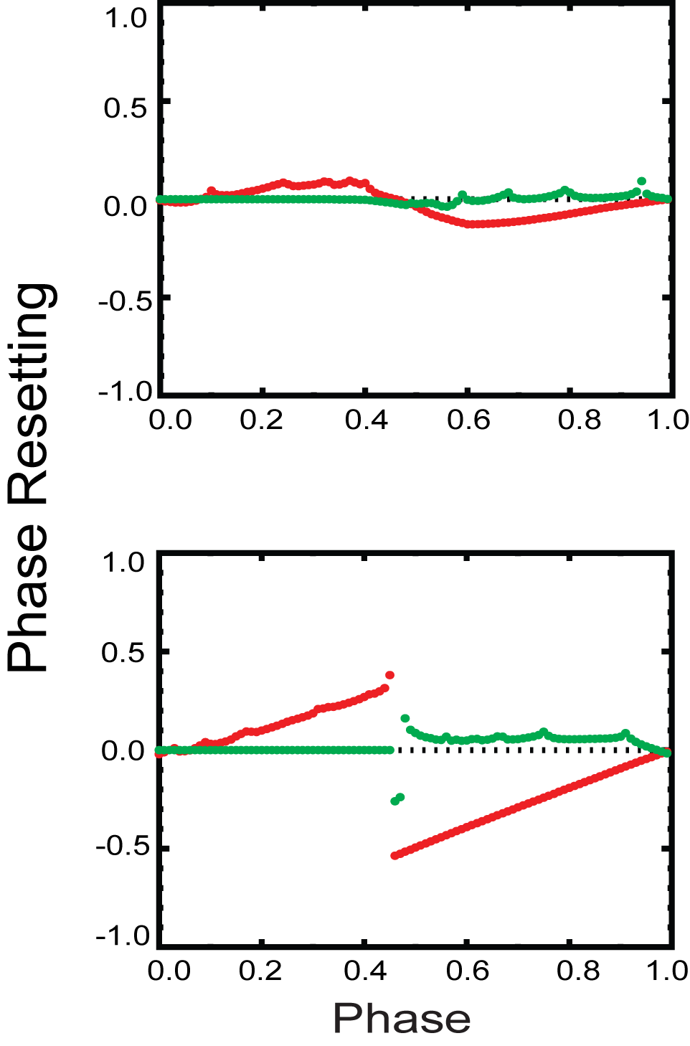
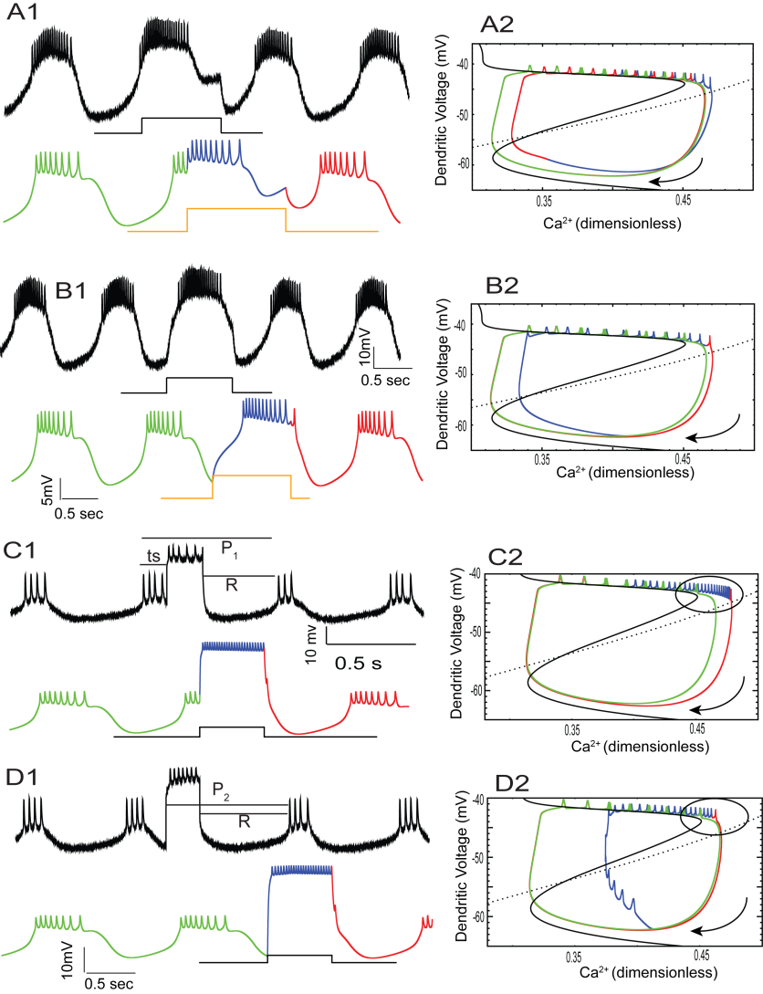
Intermediate Inputs
Cubic PRC (Weak)
F₁ F₂
Weak
Upper branch
Intermediate
lower branch
Bilinear PRC (Strong)
F₁ F₂
Strong
Intermediate
Green - Before input
Blue - During Input
Red - After Input
Notes:
PRC
Model
Top, Bottom
Caption
A1 and B1, C1 and D1
Top
A1,B1 during burst and during interburst
Explain
The inputs given during the early phases, increases the period, and the inputs given during the late phases, advance the next cycle by shortening of interburst interval (Fig. ).
Smooth transition
F2 zero
Phase plane
Green, blue, red
In fig you can see the input makes the neuron to prolong the stay in the upper branch.
In fig you can for the input given during the interburst cause the transition to the upper branch to occur sooner resulting in an advance.
Next Case (Tough to follow)
C1 and D1, Strong intermediate, during burst and during interburst
pulses given during a burst prolong the burst for the full duration of the pulse unlike ….
Linear F1, R – constant
F2 – zero
Pulses given at any point during the interburst immediately evoke spiking (which is counted as a burst in the PRC protocol)
1-phase
R – constant
F2 constant(input dur + R)
The phase plane shows that the neuron always goes to a compact phase space (shown as a black circle) which is reason for constant rebound

Slide 11
Intermediate Inputs
PRC
In general for the weak inputs in the first order resetting, the inputs given during the early phases, there is a delay, and for the inputs given during the late phases, there is an advance (Fig.). Transition from delay to advance is gradual. Except for inputs given during the very late phases, there is no significant second order resetting. When the strength of the synaptic conductance is increased, both delays and advances are accentuated resulting in a discontinuity at the transition from delay to advance.
Voltage trace
The delay in early phases is due to lengthening of both the burst and the interburst interval. The advance seen during the late phases is due to the shortening of interburst interval (Fig).
Model neuron prc
A model neuron was used to gain insight into the phenomenology of resetting of a bursting neuron in response to excitation. The model captures the cubic shape of the PRC reasonably well (Fig.).
Phase plane
Fig shows a two dimensional phase plane projection of the trajectory in the full state space. The input given during burst prolongs the neuron’s stay in the upper branch. The input given during the interburst causes a transition to the upper branch to occur sooner resulting in an advance.
PRC
For stronger pulses of the intermediate duration, we got a bilinear F₁ PRC. The F₂ is zero for phases during burst and constant for phases during interburst.
Voltage trace
The pulses given during a burst prolong the burst for the full duration of the pulse. Pulses given at any point during the interburst immediately evoke spiking (which is counted as a burst in the PRC protocol). There is an essential constant rebound time to the next burst after the end of the input.
Phase plane
Fig shows the phase plane view. The phase plane shows that the neuron always goes to a compact phase space (shown as a black circle) resulting in constant rebound

Slide 12
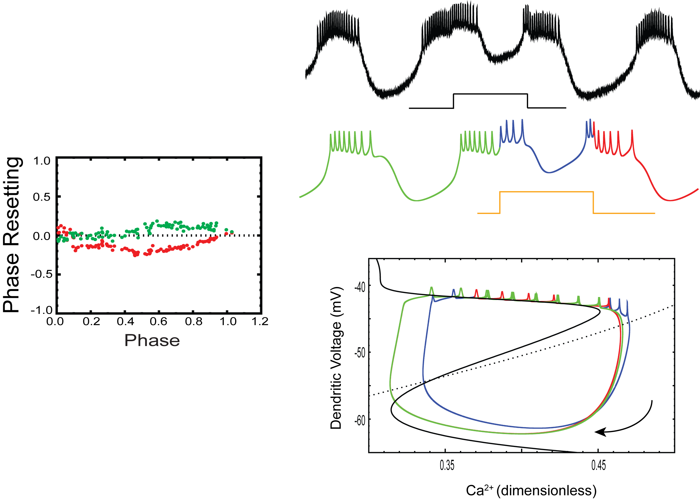
Weak Long Inputs
‘U’ shaped PRC
F₁ F₂
Green - Before input
Blue - During Input
Red - After Input
Notes:
PRC
When the duration of weak inputs are further prolonged we get roughly a U-shaped PRC.
Except for very early phases we see only advancement due to the phase resetting.
There is also significant second order resetting for the inputs given during the latter half of the cycle.
V trace
In some cases the input given during burst extends the full length of interburst interval and ends in the burst of the next cycle.
PP
Just explain
The advance is because the early transition to the next cycle is more than delay due to the stay in upper branch

Slide 13
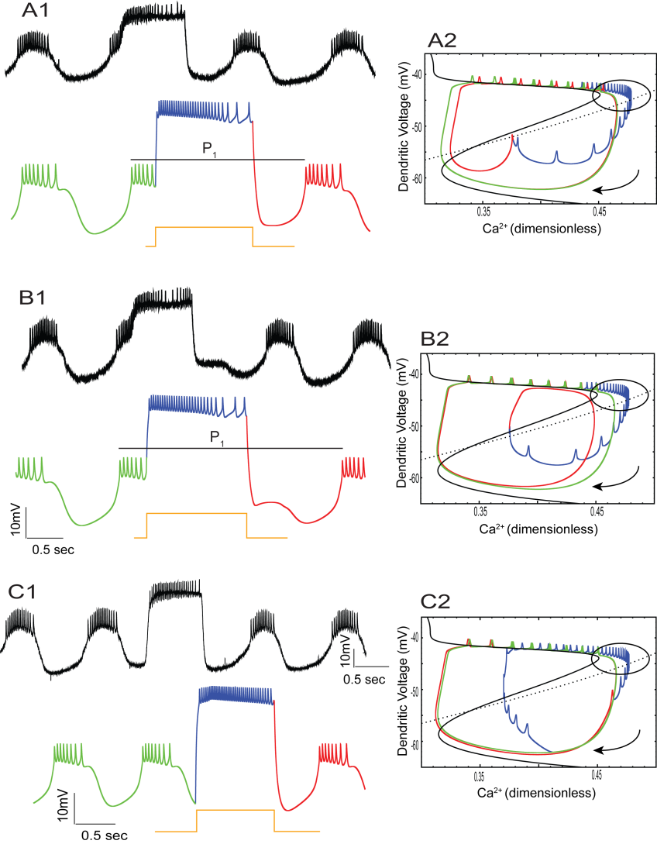
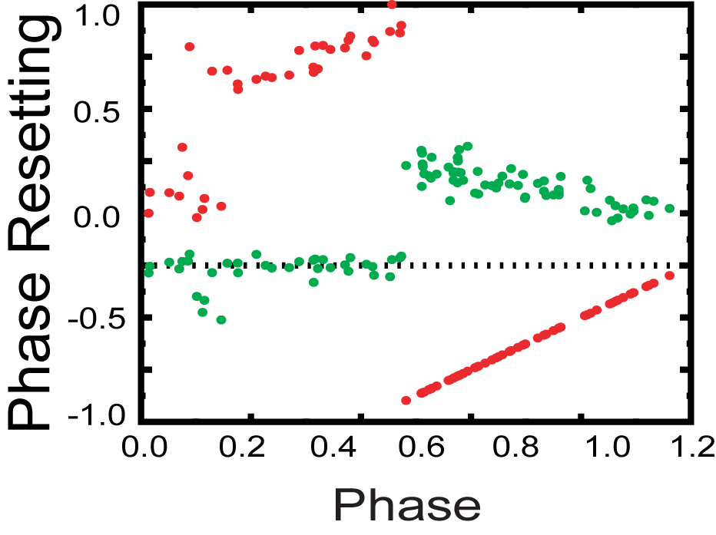
Strong Long Inputs
Trilinear PRC
F₁ F₂
Green - Before input
Blue - During Input
Red - After Input
Primary neurite
Very slowly activating K⁺ current
Notes:
PRC
Discontinuity in F1 for inputs given during burst
Tri linear PRC
Voltage trace
Just explain P1 is large for B1 than A1
PP
A2, Similar to the strong and intermediate pulses, the inputs given during the burst prolonged the burst and neuron goes to compact phase space but however it relaxes from the compact spaces and goes to lower branch but it continues spikes ……
B2, Shifts to upper branch but doesn't spike. Because of very slow outward current …………(explain further …….). That’s why u get large P1
This is unlike weak long cases, where there is immediate spikes after the input.
The neurons spikes only when input is on, irrespective of whether it is in upper branch
C2, Input given during interburst evoked the burst immediately. Goes to compact space and relaxes from compact space, and the rebound is not constant,

Slide 14
Summary of the results for Aim 2
During weak inputs
Neuron goes to a new shifted Limit Cycle
Input with Intermediate duration gives rise to cubic PRCs
Input with long duration give rise to ‘U’ shaped PRCs
Strong and short input
Branch switching is seen only at very late phases
Strong input with intermediate duration
Neuron goes to compact phase space
Rebound time is fairly constant
Bilinear PRCs
Strong and long input
The neuron relaxes from compact phase space
The next burst is terminated
Trilinear PRCs with Smaller and larger delays

Slide 15
Conclusion
The model we built was able to explain the different PRCs that we observed and was able to explain possible biophysical mechanism for the phase resetting
Since Short Strong inputs affected axon more than dendrites, one reason for not seeing the branching switching might be because we are not perturbing the dendrites effectively
For the Strong inputs, results have to be interpreted with caution as physiological inputs may not directly influence the spikes
The fact that Excitatory PRCs are more complex may be one reason why CPGs mainly rely on inhibitory synapses for their network interaction
Notes:
The branch switching explanation for the inhibitory PRCs could not explain Excitatory PRCs
Existing models did not capture the response so we built a minimal model that can explain the different PRCs.

Slide 16
Strong and long input
Strong and long input
The neuron relaxes from compact phase space
The next burst is terminated
Trilinear PRCs with Smaller and larger delays
Results have to be interpreted with caution as physiological inputs may not directly influence the spikes

Slide 17
Acknowledgement
Dr. Carmen C. Canavier.
Lab Members:
Dr. Sairam Achuthan.
Will Curry.
Shuo Guo.
Dr. Suresh K. Maran
Colloborators
Dr. Astrid Prinz (Emory Uni.).
Fred Siegling, Kavita Demla, Ryan Hooper.
Dr. Robert Butera (Georgia Tech.).

